Slide 1
Strategic Use of
Internal and External Memory in Everyday Life:
Episodic vs. Semantic Purposes
Jason R. Finley & Farah Naaz
Thursday July 15th, 2021
Cognitive Offloading Meeting 2021
jafinle@siue.edu
fnaaz1@jhmi.edu

Slide 2

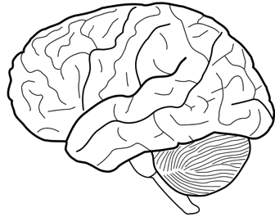


Memory is the transmission of information across time.
External Memory
Internal Memory
Notes:
Memory is the transmission of information across time.
Encoding processes send information into the future. Retrieval processes recover
information from the past.
But WHERE is memory encoded and retrieved?
Thinking beings experience time linearly. We inhabit
a single moment of perpetual change. Only memory enables subjective continuity across
moments, and the ability to adapt to challenges within a single lifetime.
With memory we can relate current experience to prior experiences, access previously encountered
information, and store the current contents of awareness for potential future use. In short,
we can exist across moments.
External memory: information stored outside of your own nervous system. could be low-tech, high-tech (power), or social (other people)
We have always been the species that extends itself into the environment.
Humans are and always have been situated beings; we adapt our cognitive practices to the current environment even as we alter that environment to expand our abilities, particularly for information storage., the Internet is a continuance of an ancient trajectory.
"The ability to store and retrieve information outside of an individual mind is a terrifically adaptive characteristic of the human species," says Finley.
"You can learn from the experiences of others. With cave drawings, oral tradition, legend, the written word, you can pass information to future generations so they don't have to learn from scratch. Knowledge becomes cumulative.”
we have come a tremendously long way as a species. from cave paintings to having supercomputers in our pockets that can access the world's accumulated knowledge.
Memory provides a way of transferring information between points in time.
Cognitive psychology = scientific study of the mind as an information processor.

Slide 3



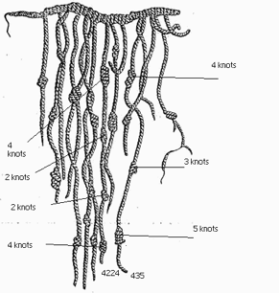
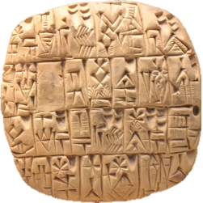

External Memory: part of the human condition
Notes:
Oral tradition: 10,000s years 100k?
Cave paintings: 10k years
Clay tablets: 1000s years. cuneiform
Quipu: ancient Incan knot external memory. existing ones 500-600 years old. probably represented crop numbers.
Printing Press: ~1440
computers, internet, cell phones: late 20th century, early 21st
The dazzling technology of the early twenty-first century is a continuation of an ancient trajectory (d’Errico, 2001; Rumsey, 2016; Staley, 2014). But as we shape our tools, to what extent do they also shape us (Culkin, 1967; McLuhan, 1962)?

Slide 4
Research Question
In the early 21st Century:
How are people using external memory in everyday life?
  to what extent is it:
    supplanting internal memory?
    extending internal memory?
The answer may depend on the purpose that memory is used for…
Notes:
this is just one of many…
NOTE: this is a descriptive/observational question!!! WHAT ARE PEOPLE DOING! Need to know that before we go nuts with hypothesis testing…
What are peoples’ attitudes and beliefs about external memory?

Slide 5


Finley, J. R., Naaz, F., & Goh, F. W. (2018). Memory and technology: How we use information in the brain and the world. Springer.
ISBN : 978-3-319-99168-9
Crowdfunded via Experiment.com !
Jason Finley
S. Illinois U. Edwardsville
Francine Goh
U. Nebraska-Lincoln
Farah Naaz
Johns Hopkins U.
Notes:
Finley, J. R., Naaz, F., & Goh, F. W. (2018). Memory and technology: How we use information in the brain and the world. Springer.
ISBN : 978-3-319-99168-9
https://www.springer.com/us/book/9783319991689
https://www.amazon.com/Memory-Technology-Information-Brain-World-ebook/dp/B07FMT8ZT6/

Slide 6
Method (Finley, Naaz, & Goh, 2018)
Survey
Participants
  N = 476 MTurk
  Summer 2015
Questionnaire
  136 Qs
  mostly rating scales
  some open-ended
“Internal memory refers to information stored in your own brain. External memory refers to information stored in the world outside of your brain, and it could be low-tech (e.g., paper) or high-tech (e.g., computer).”
126. Something that human memory works better for:
127. Something that external memory works better for:
Notes:
Mechanical Turk
257 males, 215 females, and 4 who did not specify sex
age from 18 to 75 (M = 34.7. SD = 11.2, Mdn = 32)
Text from instructions:
Internal memory refers to information stored in your own brain. External memory refers to information stored in the world outside of your brain, and it could be low-tech (e.g., paper) or high-tech (e.g., computer).

Slide 7
Results (Finley, Naaz, & Goh, 2018)
Different types/purposes of memory
passwords, names, trivia (internal)
“stone cold facts” (external)
“Storing and replaying the most precious and nostalgic moments of our lives.” (internal)
“to record events so that other people can have access to them like videotaping a wedding” (external)
“Skills learned for specific reasons. You cannot rely on notes to do everything for you.” (internal)
recipes, instructions, GPS directions (external)
Episodic: specific experiences
Semantic: general knowledge
Procedural: knowing how to do things
Prospective: remembering to do a future task
to-dos in the near future (internal)
appointments/to-dos further in the future. “An alarm will never forget what time something is” (external)
126. Something that human memory works better for:
127. Something that external memory works better for:
Wow! A beautiful crossover interaction, from messy qualitative data…
Notes:
QUALITATIVE CODING: we saw patterns in responses…
episodic: last time you saw a live possum, or birthday party. or voted yesterday!
semantic: capital of Missouri, your email address password
procedural: how to log into GriffinNet, how to make a piña colada, how to drive a car
prospective: remembering to finish grading
Episodic purposes were more likely to be mentioned for internal than external memory, and vice versa for semantic purposes
Q126 (internal memory), “Something that human memory works better for:”
127 (external memory), “Something that external memory works better for:”
NOTE: open-ended Qs
Qs 121 & 122 showed similar results
“Cooking. Recipies are only a guideline. The exact steps are hard to explain, you kind of have to just know.” (internal)

Slide 8

Let’s ask people even MORE directly about their different uses of internal and external memory.
  and straight-up tell them about the episodic vs. semantic distinction, etc.
  see if we replicate our previous results…

Slide 9
Method (Finley & Naaz, 2021)
Hopefully!
Participants
  N = 51 undergraduates
  Spring/Summer 2020
Experimental design
  IV1: form of memory
    internal memory (“information stored in your own brain”)
    external memory (“information stored in the world outside of your brain…”)
  IV2: purpose of memory
    episodic (“memory of personally experienced past events”)
    semantic (“memory of factual information”)
    procedural (“memory of how to perform a task”)
    prospective (“remembering to do something in the future”)
  DVs: 1-7 ratings on frequency of use, dependability, and ease of use
Notes:
and we def
Age: 18-40 M = 20.82, SD = 4.64

Slide 10
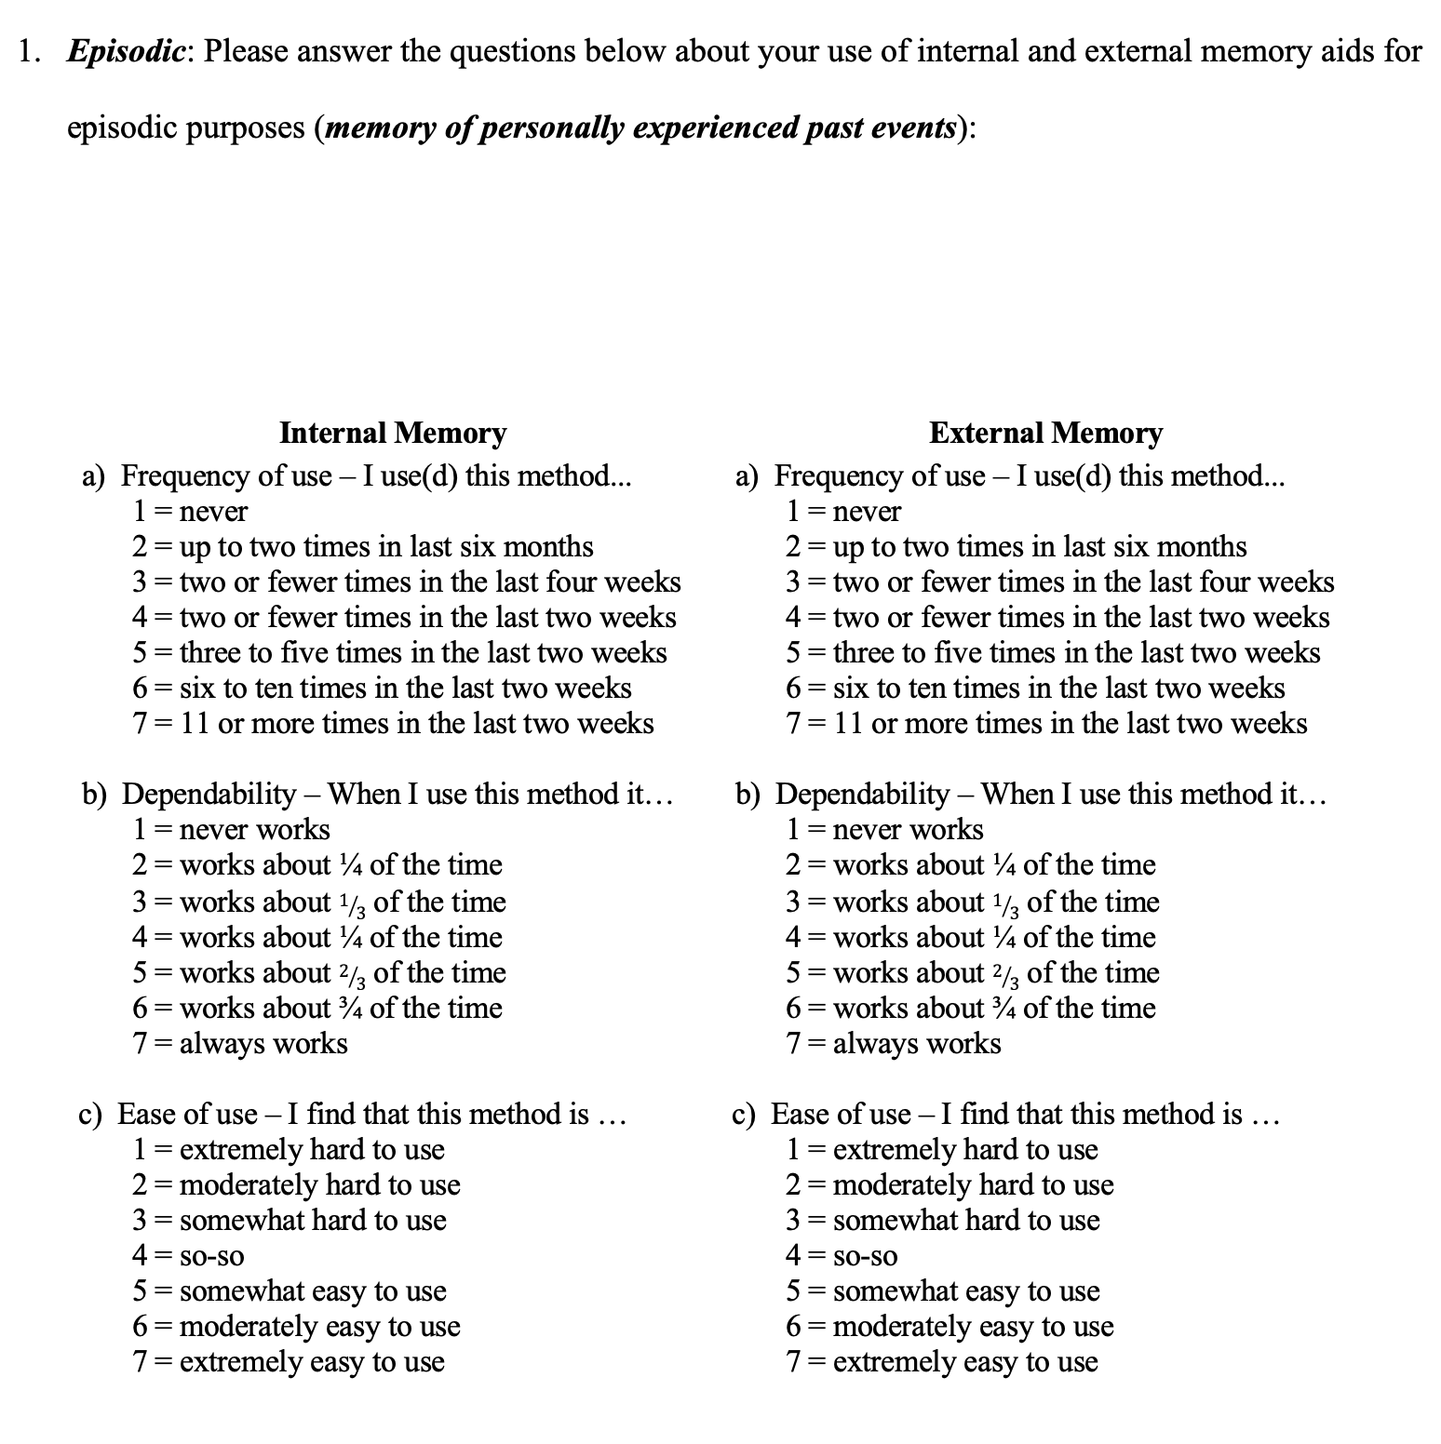
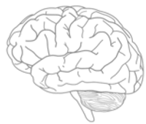

Method
Scales adapted from Intons-Peterson & Fournier (1986)
Notes:
adapted from Intons-Peterson Fournier (1986), frequency scale originated with Harris (1980).
2 x 4
3 DVs…

Slide 11
Results (Finley & Naaz, 2021)
Mean Frequency of Use for Internal and External Memory Across General Purposes
≥ 11 times in past two weeks
≤ 2 times in
past two weeks
Notes:
People use internal memory (information in the brain) and external memory (information outside the brain) to varying extents for different purposes. The results from Part 1 of the current study (Figure 2) replicated a crossover interaction (Finley et al., 2018, shown in Figure 1)—for episodic purposes, internal memory was used more frequently than external memory; for semantic purposes, external memory was used more frequently than internal memory. Furthermore, for procedural purposes internal memory was dominant, and for prospective purposes external memory was dominant.
Note. Error bars represent the standard error of difference scores for internal versus external memory. 1 = never, 7 = 11 or more times in the last two weeks (See Table 1).
4 = two or fewer times in the last two weeks

Slide 12
Interplay of Internal & External Memory (from Finley et al., 2018)
Notes:
The division of labor makes sense. We’re distributing cognitive tasks across both the internal and external memory resources available to us in a way that plays to the strengths of those resources and meets the needs of particular purposes.
quotes
Both forms of memory can expand on each other. Internal memory can expand on external memory by yielding rich recollections of original experience. External memory can expand on internal memory by providing more detailed information. Several responses illustrated this mutual augmentation (Table 21).
“External storage is only functional if it is represented internally. ... It is the user who has to initiate and to organize the retrieval at the appropriate time for the purpose given. To be able to do this he has to know the content, the location, the structure and the operational features of the external store.” (Schönpflug, 1986b)

Slide 13
Strategic Use of
Internal and External Memory in Everyday Life:
Episodic vs. Semantic Purposes
Thank you!
Jason R. Finley & Farah Naaz
Thursday July 15th, 2021
Cognitive Offloading Meeting 2021
jafinle@siue.edu
fnaaz1@jhmi.edu

Slide 14
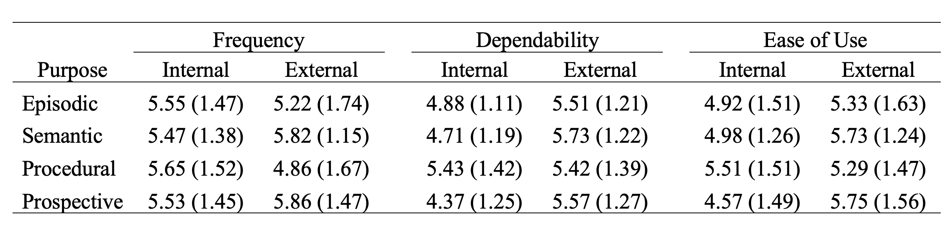
Notes:
Dependability and ease of use were generally rated higher for external memory than internal memory (Tables 3 and 5). This is consistent with the findings of Intons-Peterson and Fournier (1986, Table 4), which was the only prior study that asked about these variables.

